Slide 1



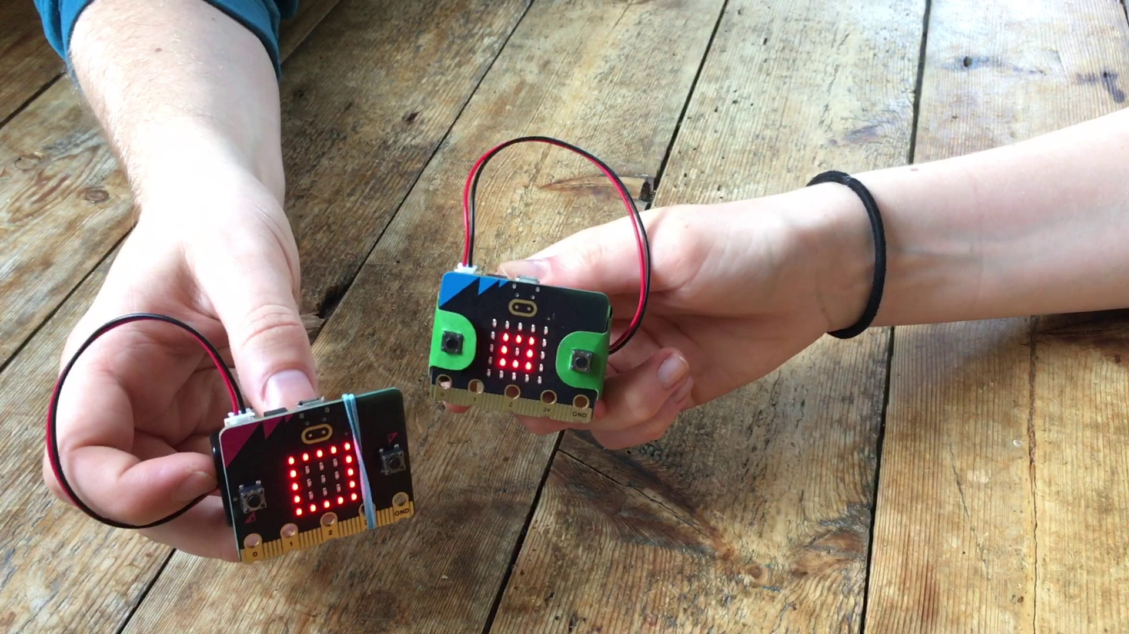


Lesson 6 Rock, paper, scissors

Slide 2
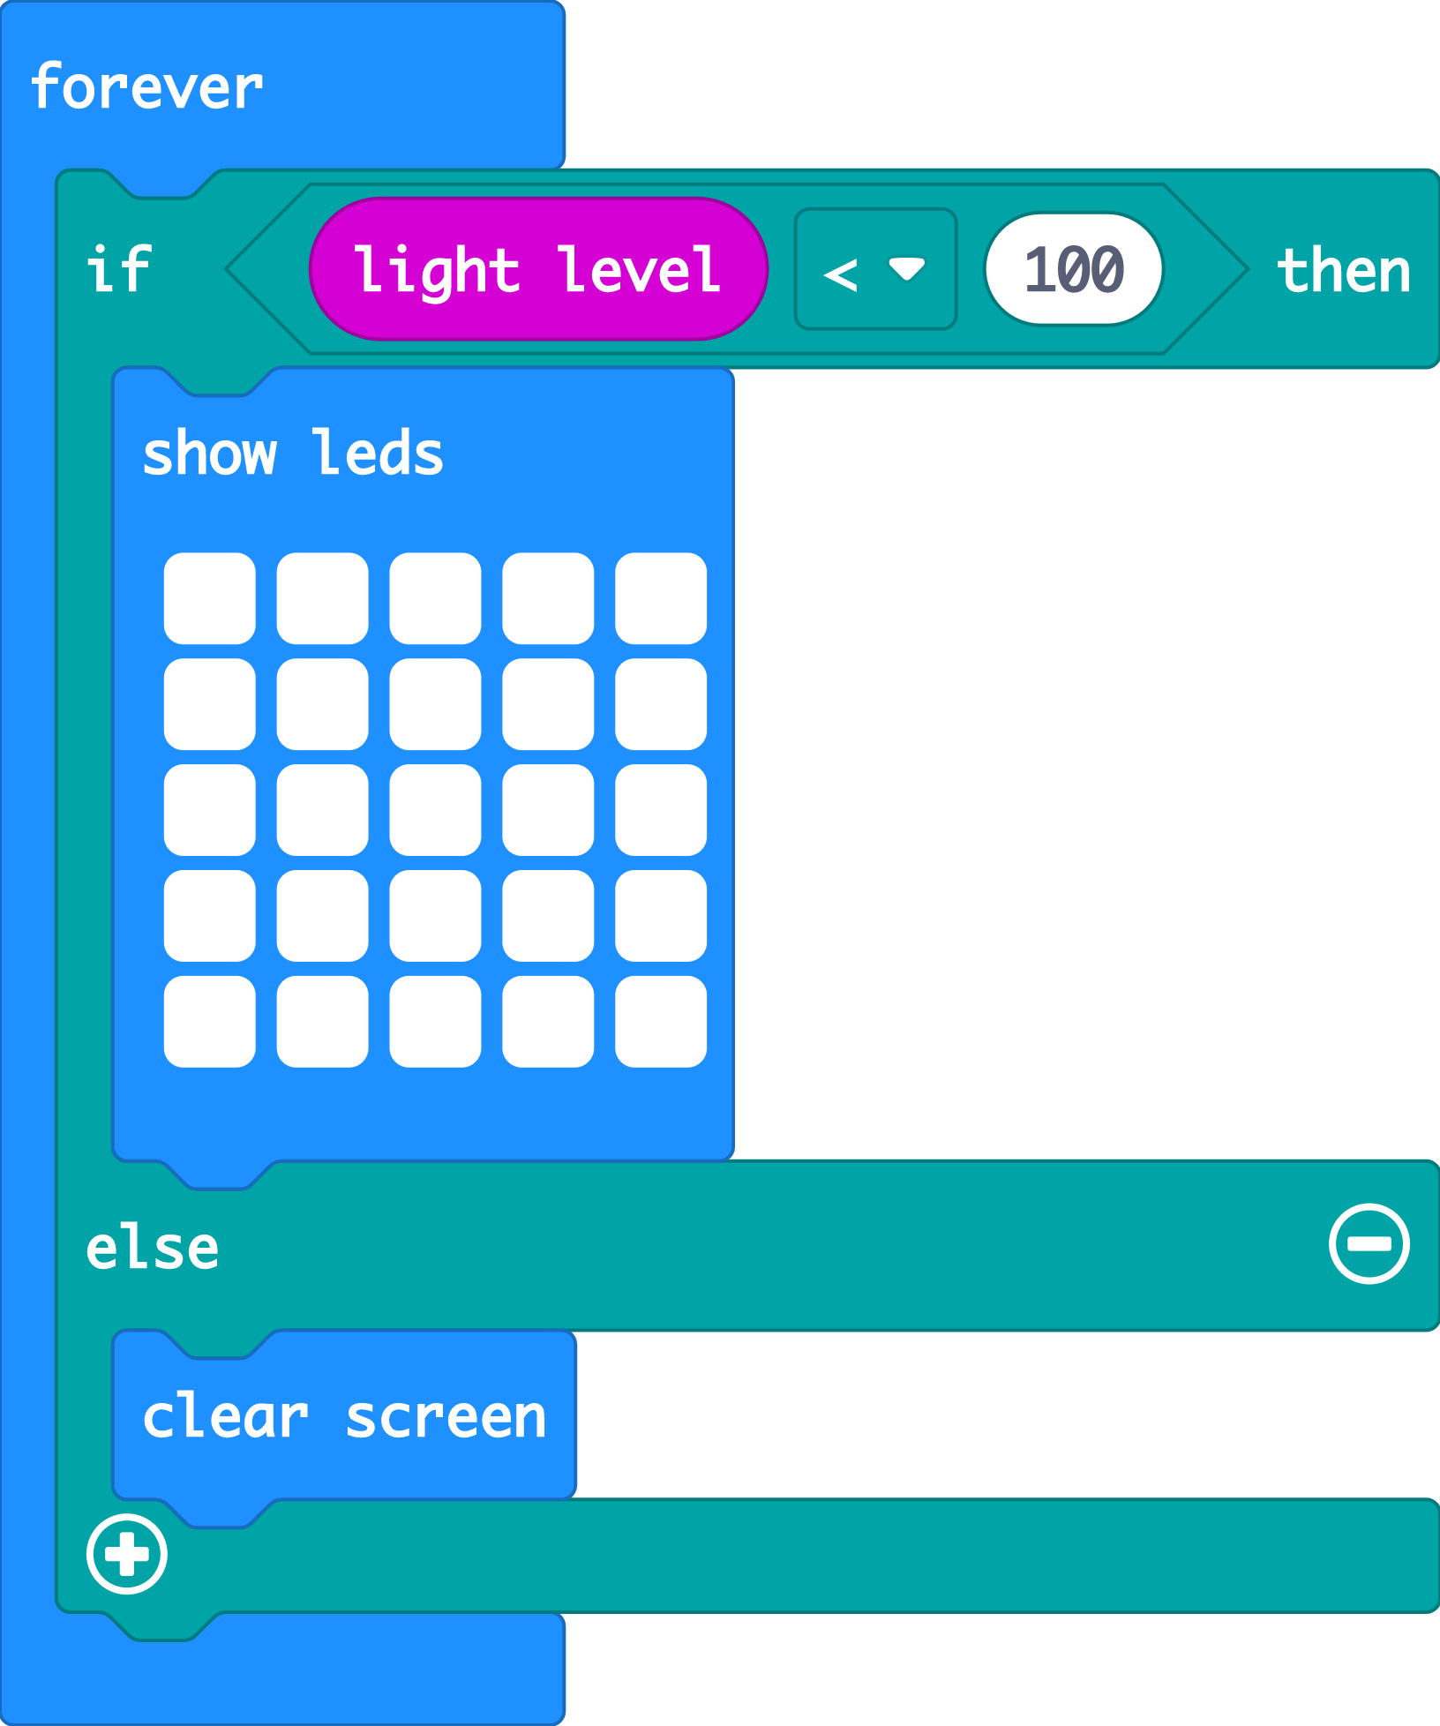
Recap: nightlight
Last time we coded our micro:bits to make a light that switches on when it gets dark using sensors and logic.
Today we’re going to use the accelerometer sensor and even more logic to make a micro:bit simulation of a well-known game.
Notes:
A simulation is a computer version, or model, of something in the real world. The MakeCode editor has a simulator of a real micro:bit, for example.

Slide 3





Think: learning objectives
I can code a micro:bit Rock, paper, scissors game using inputs, random numbers, variables and logic.
I can explain how combining inputs, random numbers, variables and logic can make a computer simulation of a real-world game.
Notes:
Ask
What is an input?
What input would be useful to use in this game? (The accelerometer is a good input to use because it can sense when we shake the micro:bit which fits the game.)
What are random numbers? (Talk about examples like dice. Is a dice more random than a human playing rock, paper, scissors? Do your students think a computer will be truly random?)
What are variables? (We used variables in the step counter project to keep track of our steps. Today we’re going to use them so we can test a random number and show different pictures depending on its value.)
What is logic? (We used logic in the nightlight project to turn the light on if it was dark. Here we’ll use logic in the form of if-then-else blocks to make different pictures appear to represent rock, paper, or scissors depending on the random number generated by the micro:bit.)
A simulation is a computer version, or model, of something in the real world. The MakeCode editor has a simulator of a real micro:bit, for example.

Slide 4
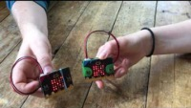



Think: rock, paper, scissors introduction video
Optionally play video: https://youtu.be/8wFIZLLBbuk

Slide 5

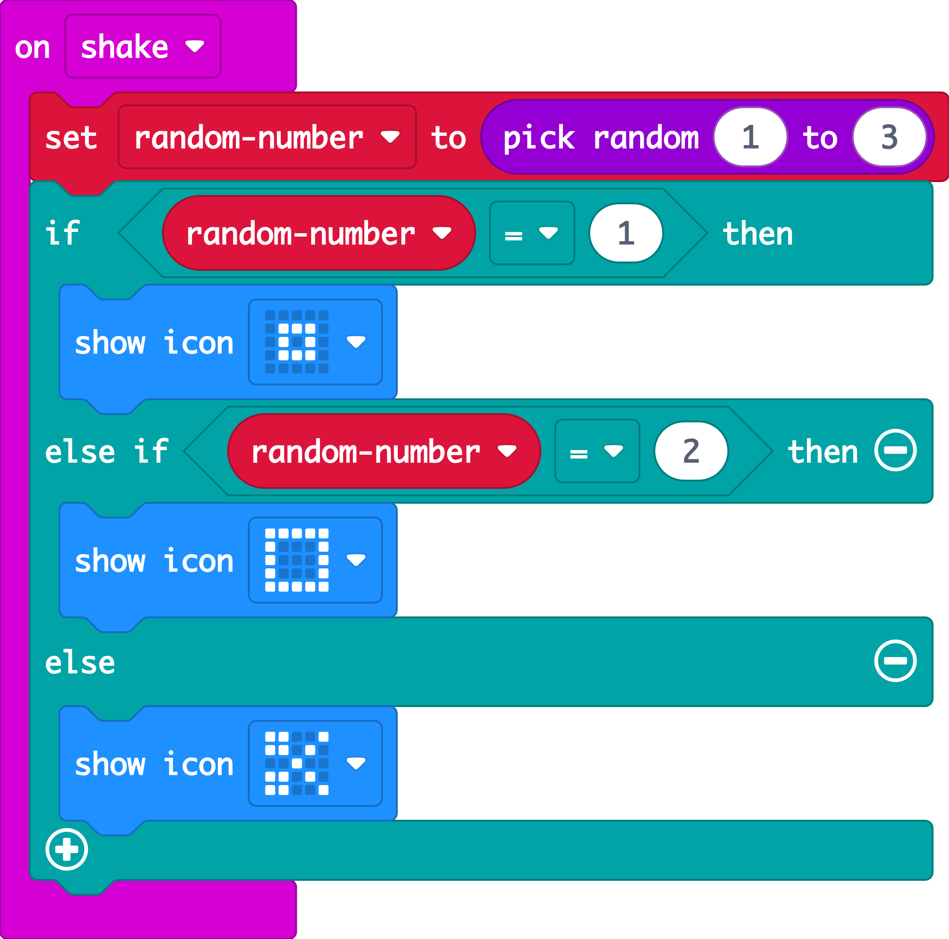

Create: examine the code
The accelerometer sensor input triggers the ‘on shake’ block.
A random number between 1 and 3 is stored in a variable called ‘random-number’
The logic ‘if… then… else’ block tests the value of the variable.
If the number is 1, it shows a rock icon.
If the number is 2, it shows a paper icon.
Else, otherwise, if the number is not 1 or 2, it must be 3, so it shows the scissors icon.
Teacher: open the completed code in the editor
Notes:
We don’t need to test if random-number = 3 because we’re using logical thinking. If the number is not 1 or 2, it must be 3.
Completed code: https://makecode.microbit.org/#pub:_4ChUTXM8od9P

Slide 6

Create: build the code
Open a new MakeCode project https://makecode.microbit.org/
Notes:
You can follow the link to open a new MakeCode project and model building the code yourself – or use slide 7 to show a YouTube coding video, or slide 8 to show an animated GIF of building the code if YouTube is blocked in your school.

Slide 7

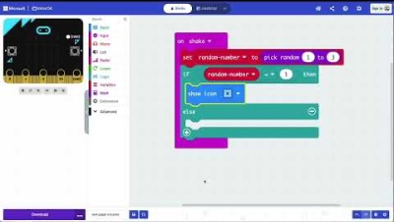
Create: coding video
Coding video: https://mbit.io/lessons-rock-code-video
Notes:
Optionally share this YouTube coding video with your class: https://mbit.io/lessons-rock-code-video

Slide 8


Create: coding animation
Notes:
Animated GIF of building the code you can share with your students, if YouTube is blocked in your school.

Slide 9
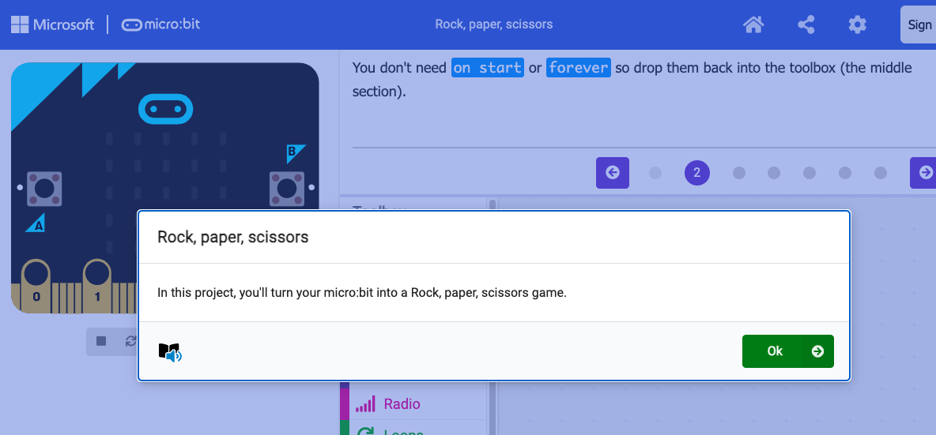
Create: step-by-step online tutorial
https://mbit.io/tutorial-rps
Notes:
You can optionally share this online step-by-step tutorial with your students to follow individually.

Slide 10



Evaluate
Download your code to a micro:bit
Does it work as you expect?
How good is the project? Do you think the micro:bit is a fair opponent? Is it a good simulation of the game?
Could it have other uses?
How does it work?

Slide 11


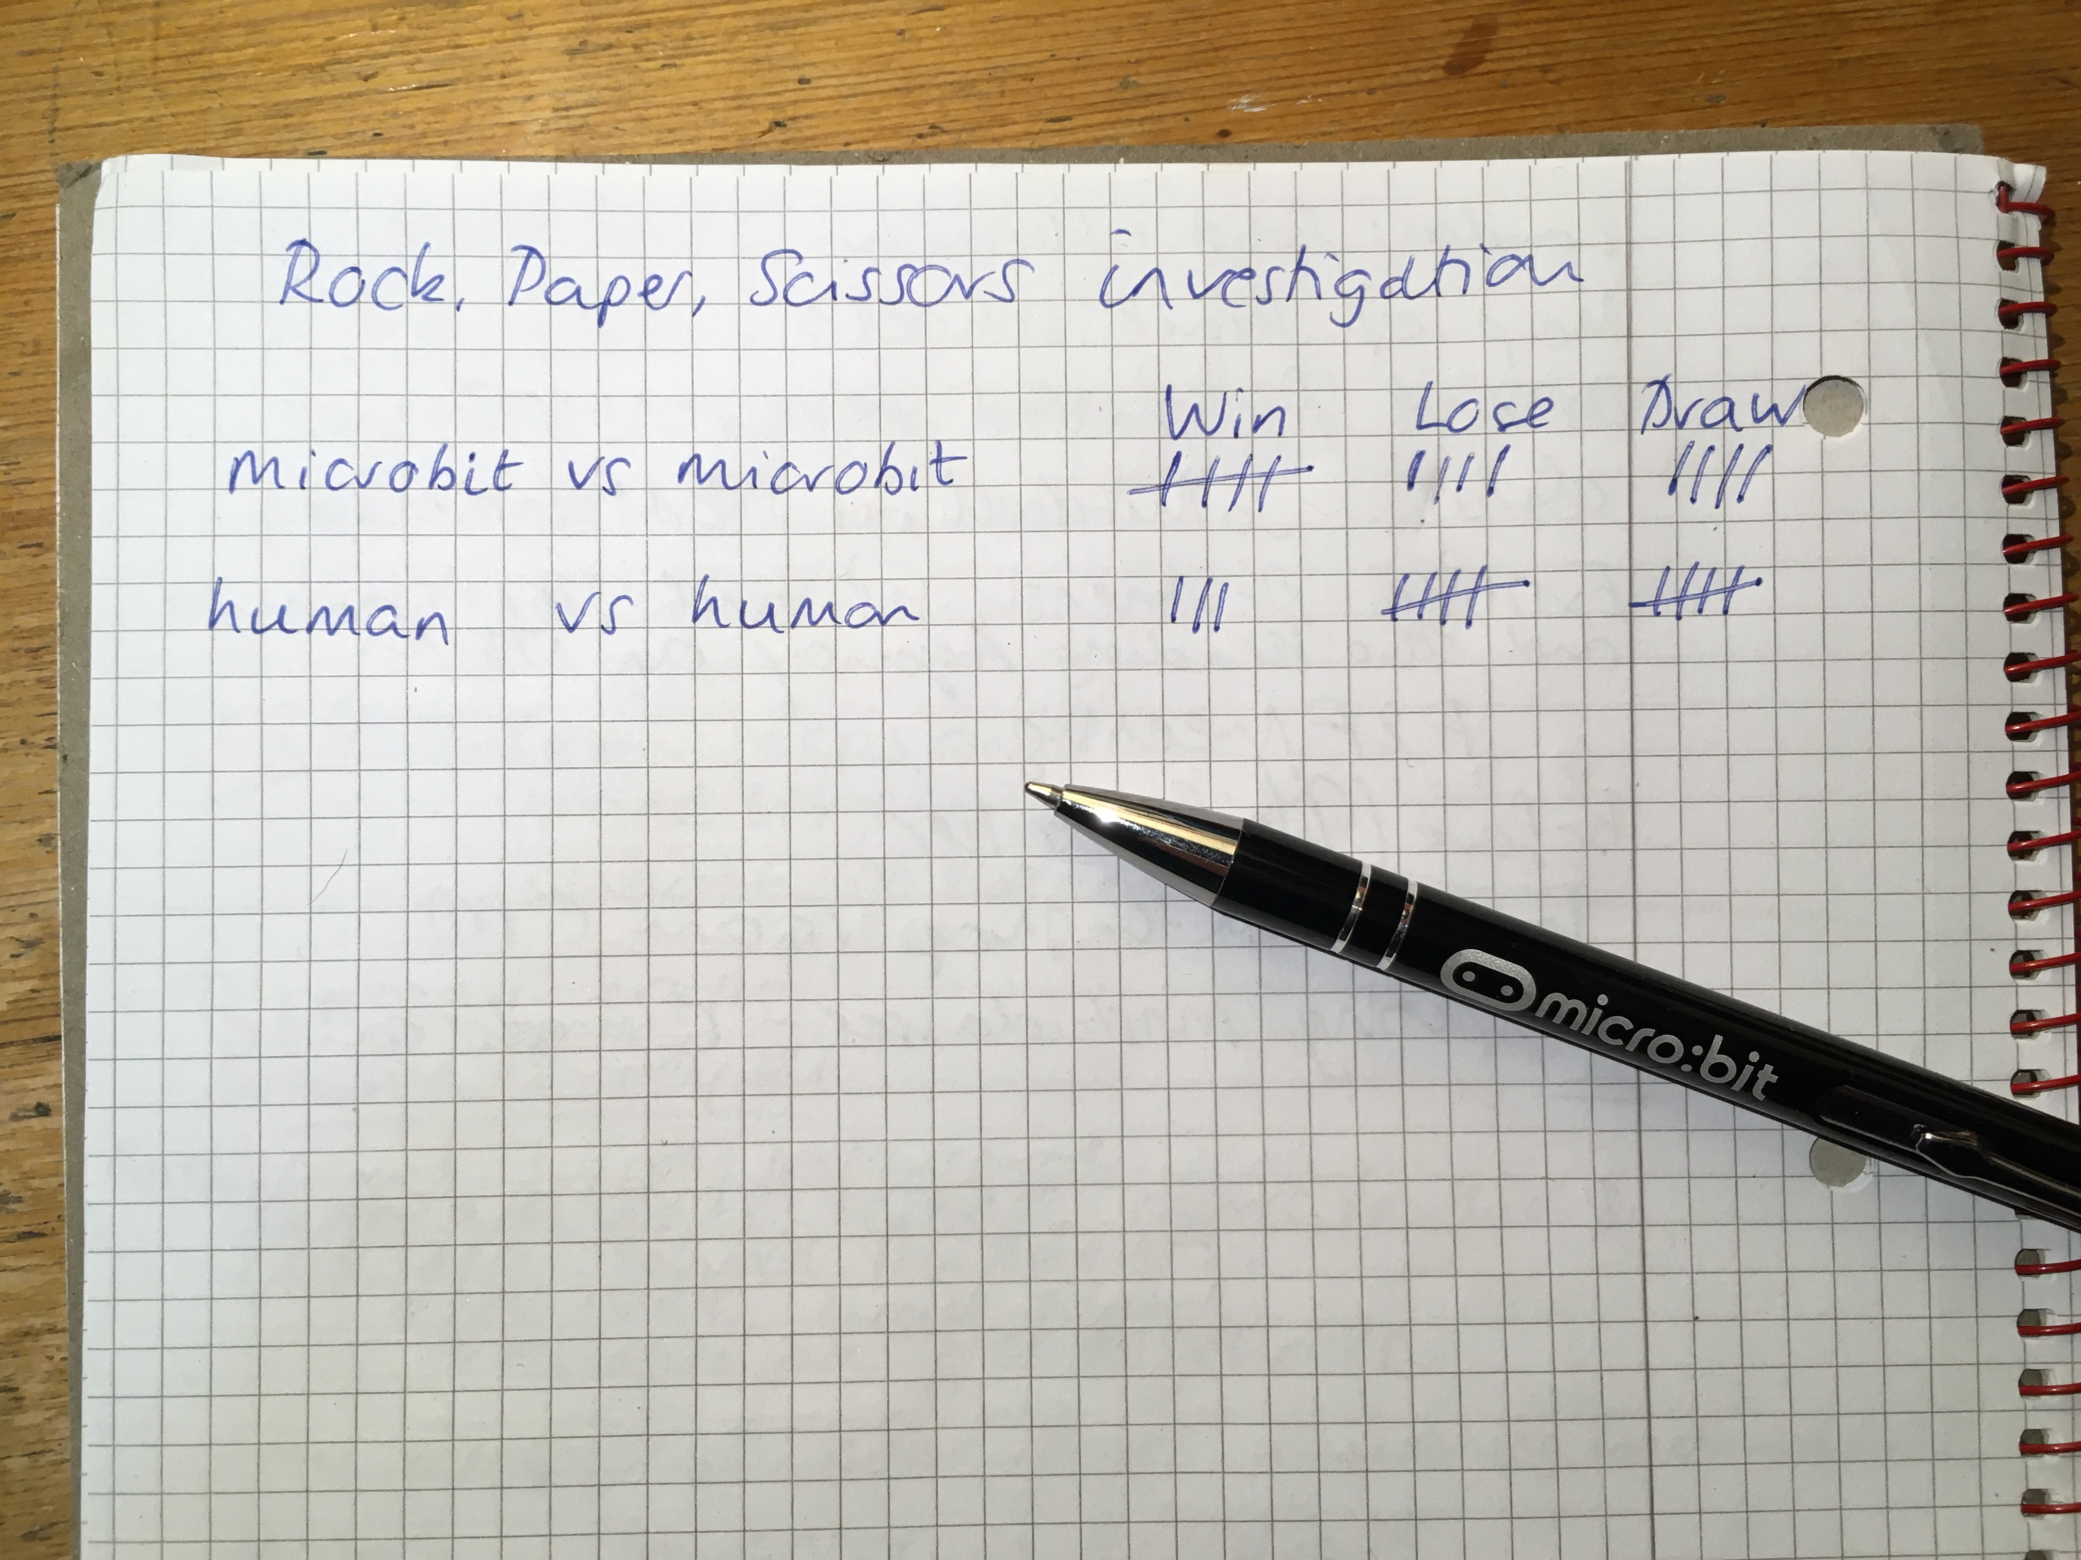
Extend
Make a tally chart to record how many games the micro:bit wins, losses or draws when playing against a human opponent… or against another micro:bit.
Can you modify the code to make your own game?
Notes:
Students might design their own icons and make new rules about which objects beat other objects.

Slide 12

Share: revisit the learning objectives
I can code a micro:bit Rock, paper, scissors game using inputs, random numbers, variables and logic.
I can explain how combining inputs, random numbers, variables and logic can make a computer simulation of a real-world game.
Notes:
Ask:
How random were the numbers? How fair is the micro:bit game compared with a human opponent? (Students may have found that the micro:bit is more fair than a human, because it can’t cheat. The normal game is only fair if both players show their hands at exactly the same time!).
Why did we use a variable? (So we could set its value to a random number and test it to see which picture to show. If we didn’t use a variable, we would not be able to do this.)
Why did we not test if the variable value is 3? (Using logical thinking, we made the code more compact. We know the variable has a value of 1, 2 or 3. If the variable is not 1 or 2, it must be 3.)

Slide 13

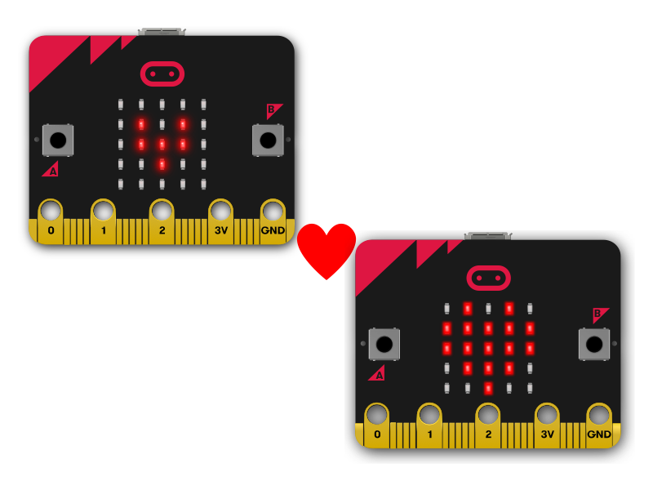
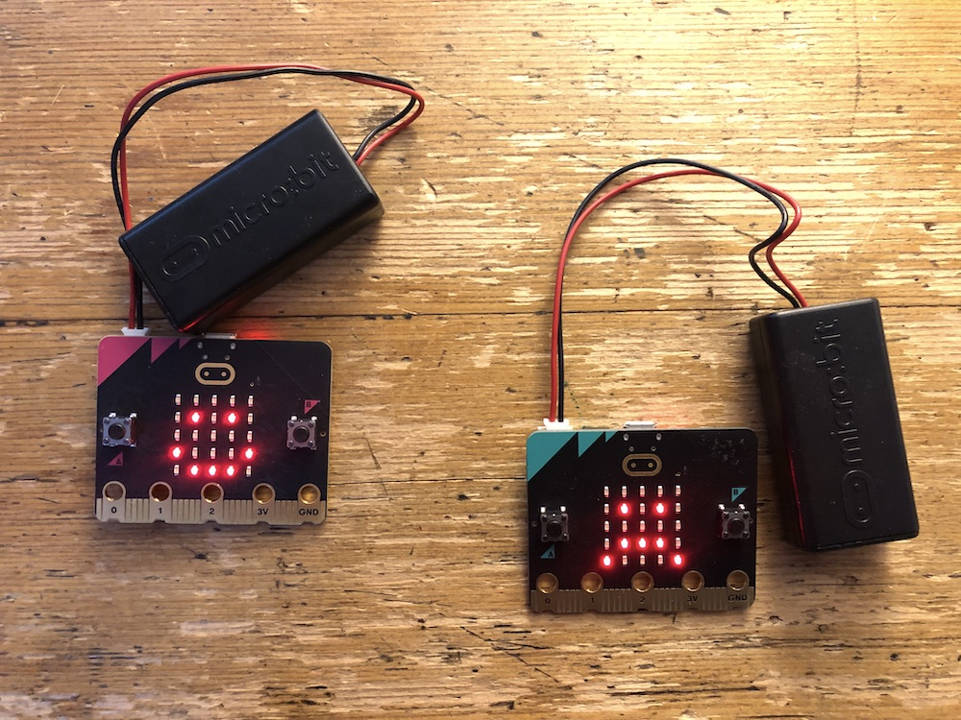
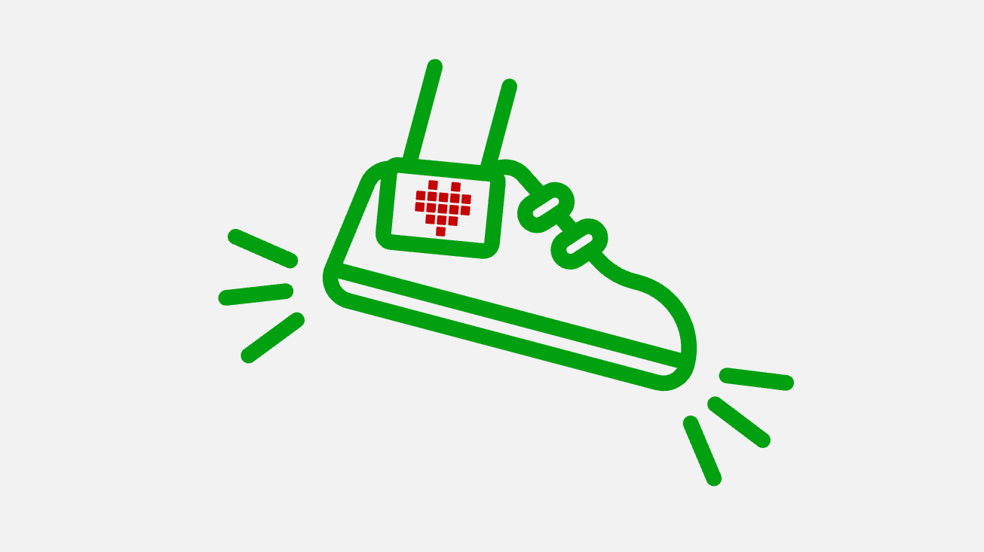
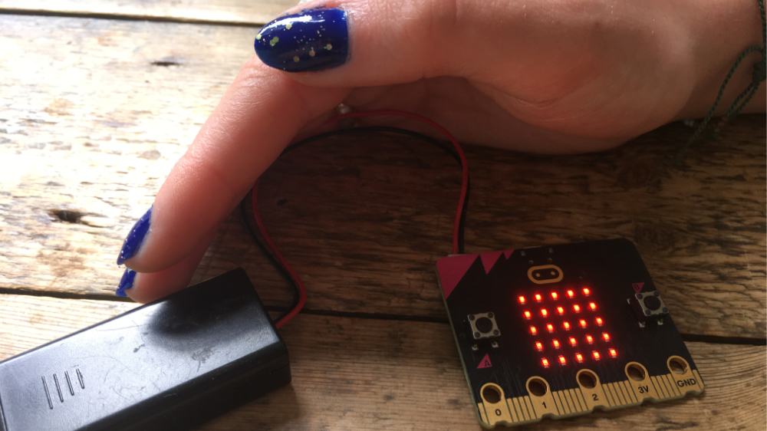
Next steps
In these six lessons, you’ve used outputs (LED display) to show words, numbers, pictures.
Created sequences to make animations.
Used button inputs and abstraction to show how you feel.
Used the accelerometer and variables to make a step counter.
Used sensors and logic to make a nightlight.
Simulated a game of chance using more complex logic.
What are you going to make next?

